Slide 1

Artificial Intelligence - CIE 458
Fall 2022
Mohamed Nasr 201-801-675
Abdullah Muhammad 201-801-271
Amr Abdelaziz 201-801-041

Slide 2
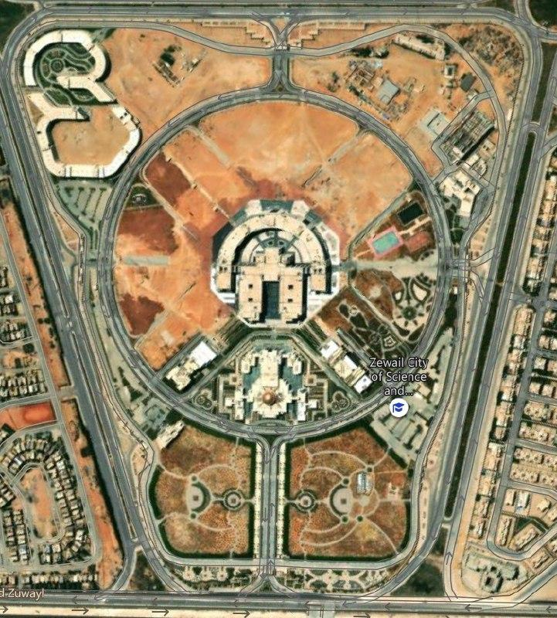
Zewail City Map

Slide 3
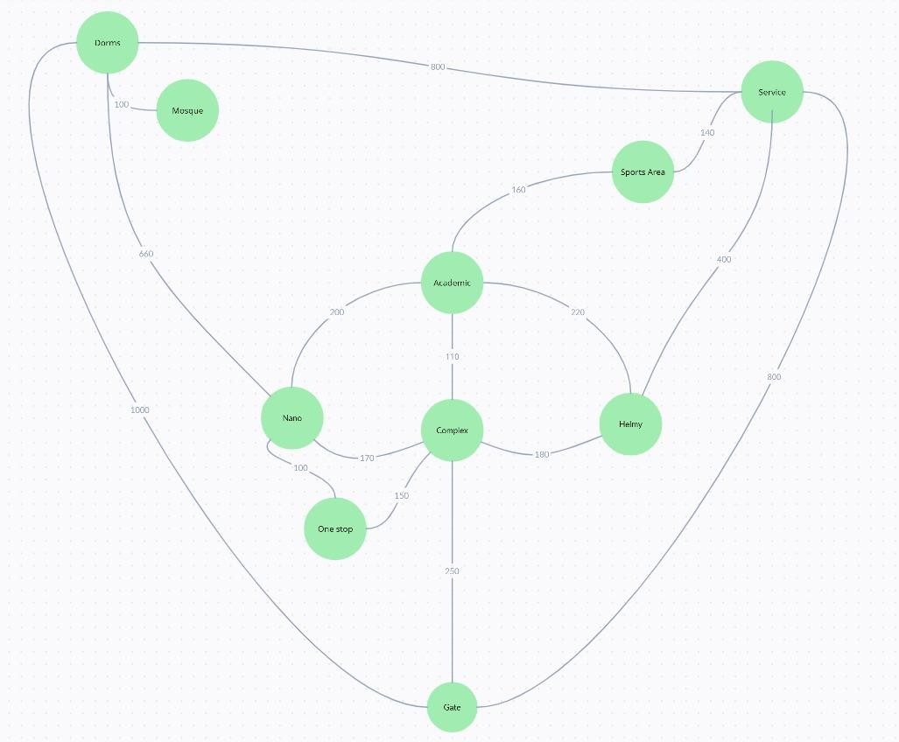
Zewail City Design

Slide 4
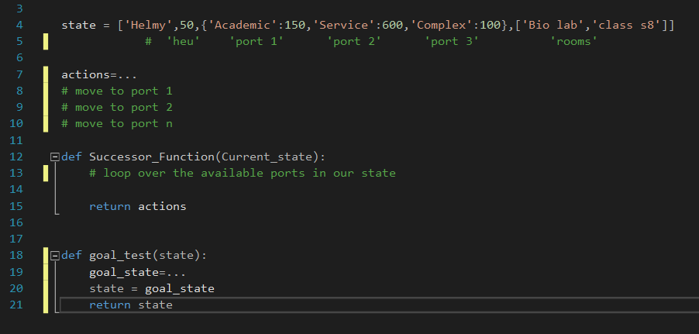
Thinking Process

Slide 5
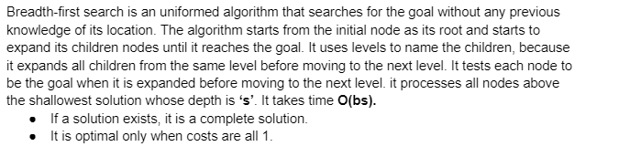
BFS

Slide 6
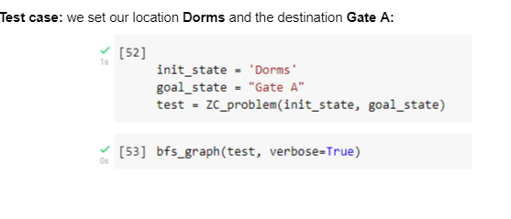
BFS - Test Case

Slide 7
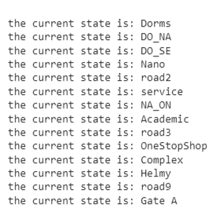
BFS - Test Case Output

Slide 8
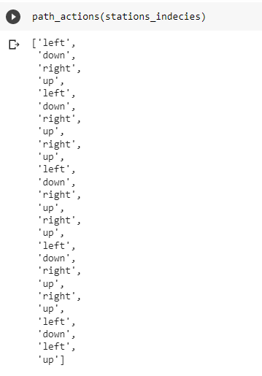
BFS - Test Case Output

Slide 9
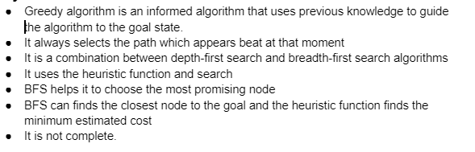
Greedy best-first

Slide 10
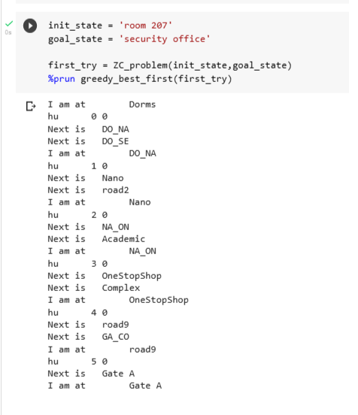
Greedy best-first
- Test Case

Slide 11
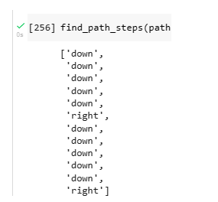
Test Case - Output

Slide 12
To be continued..

